Slide 1
Soccer Player position prediction
By Venkatesh Prasad
Data science with Python 677 project

Slide 2
Objectives
Description of the dataset
Data Preprocessing
Visualization of sample feature of players
Normalizing the features
Predict positions of player with Classifiers
PCA
Evaluation
Conclusion

Slide 3
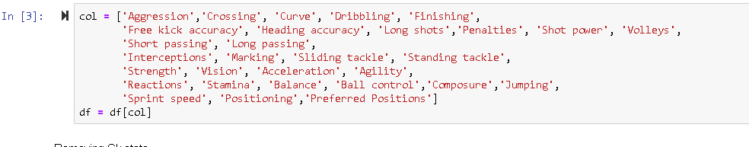
Description of dataset
The dataset is kaggle https://www.kaggle.com/thec03u5/fifa-18-demo-player-dataset
The features are players performance in different skill set
Players preferred position as player prospect to justify sport as class att.
15952 players stats ,75 attributes

Slide 4
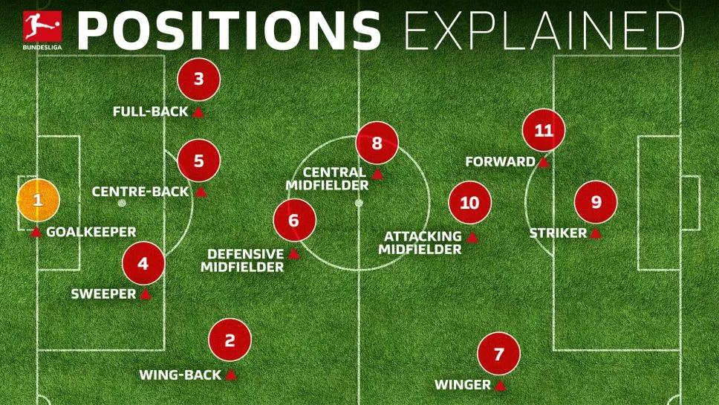
Data Preprocessing
Remove the GoalKeeper’s
Remove spaces before and after the classifier attribute
Assign values to forward attacking , defence and midfield

Slide 5
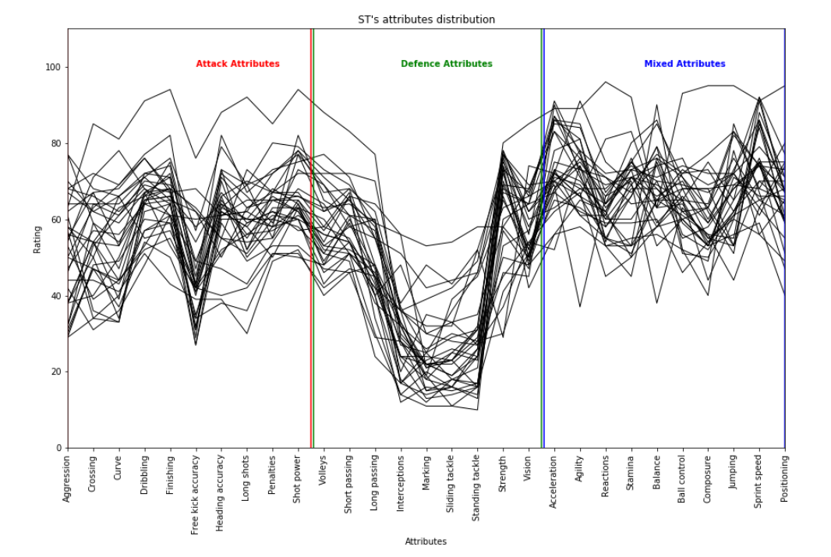
Visualization of sample features
Striker sample for the data set
Number of samples : 200

Slide 6
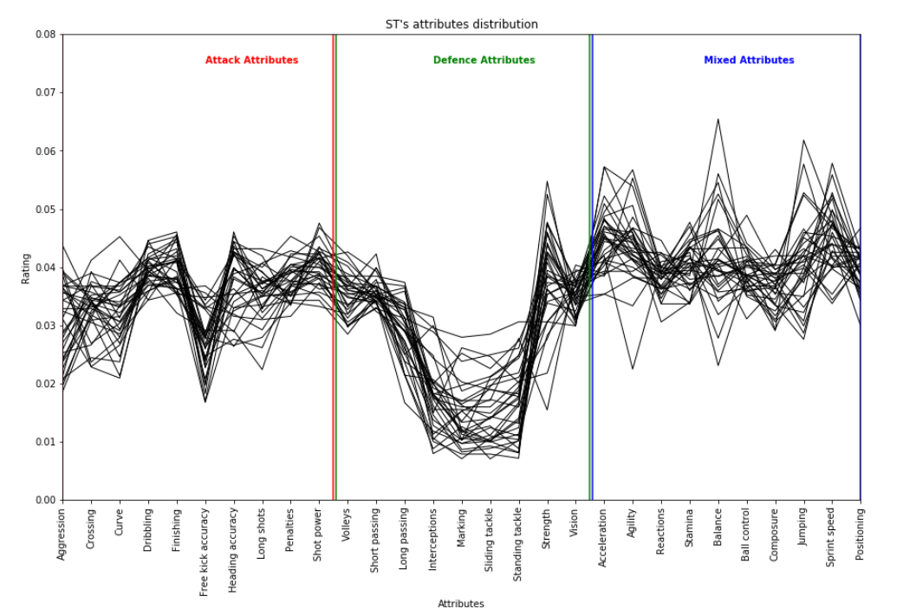
Visualization after normalization
Normalized striker attrib

Slide 7
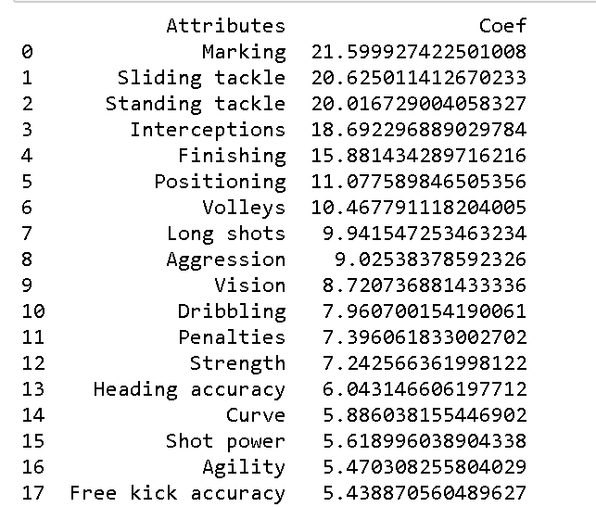
Classify
Classifiers Used
Logistic regression
Neural Network
Random forest
Gaussian Naive bayes

Slide 8

PCA
PCA takes the best features and boosts accuracy for a model . However ,
The Principal component analysis had a lower accuracy for the best 15 features is reduced to 44% .
The reason for reduction in accuracy due to further scaling of normalized data .

Slide 9
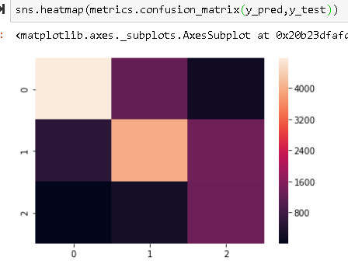
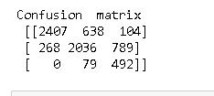
Evaluation & Conclusion
The accuracy confusion matrix has 0,1,2 as defence ,midfield , Attack Respectively .
Neural network has the
best accuracy of 75.3 %

Slide 10
Thank you

